Slide 1
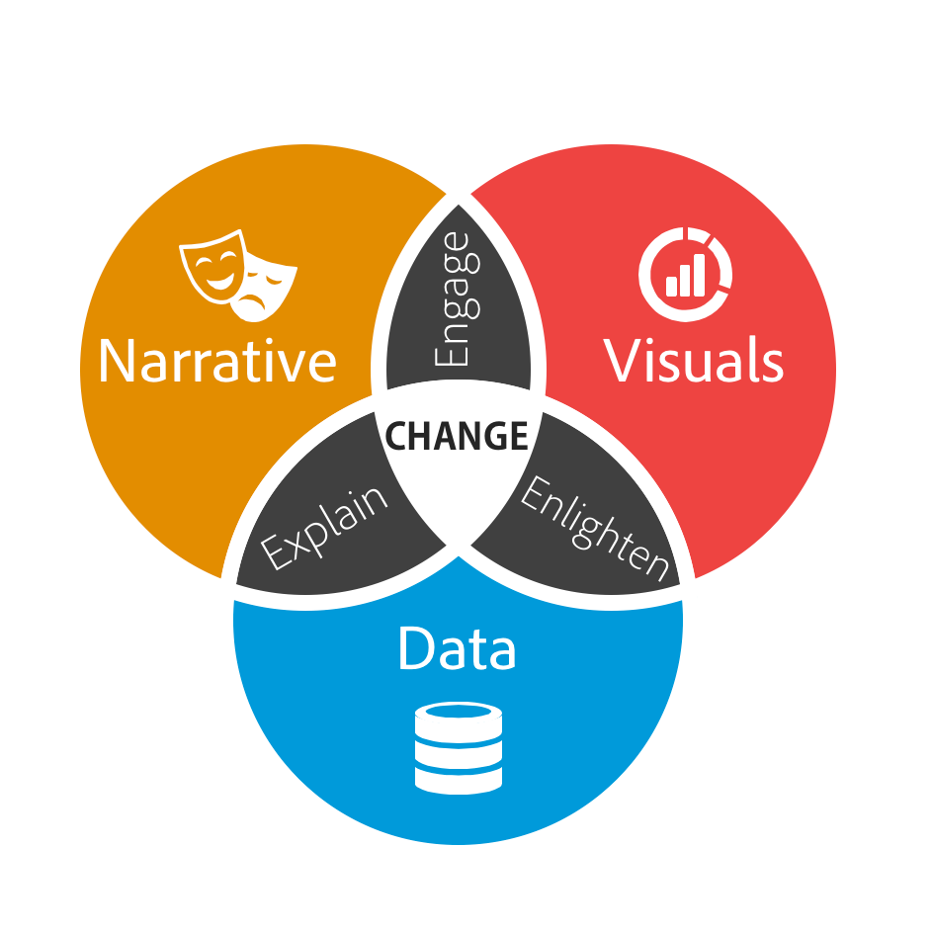
Spotify Dashboard Project
Assignment 2
Presented By:-
Sneha Jayachandran (23979684)
Undram Chinges (24498014)
Pavithra Devi Balashanmugam (24251484)
Muhammad Aariful Islam (24584192)
Saloni (24557371)

Slide 2
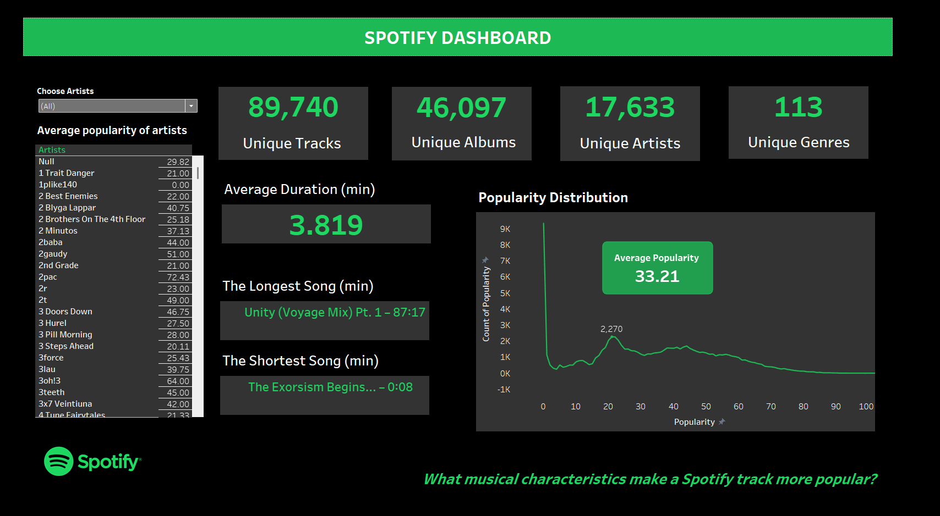

Slide 3
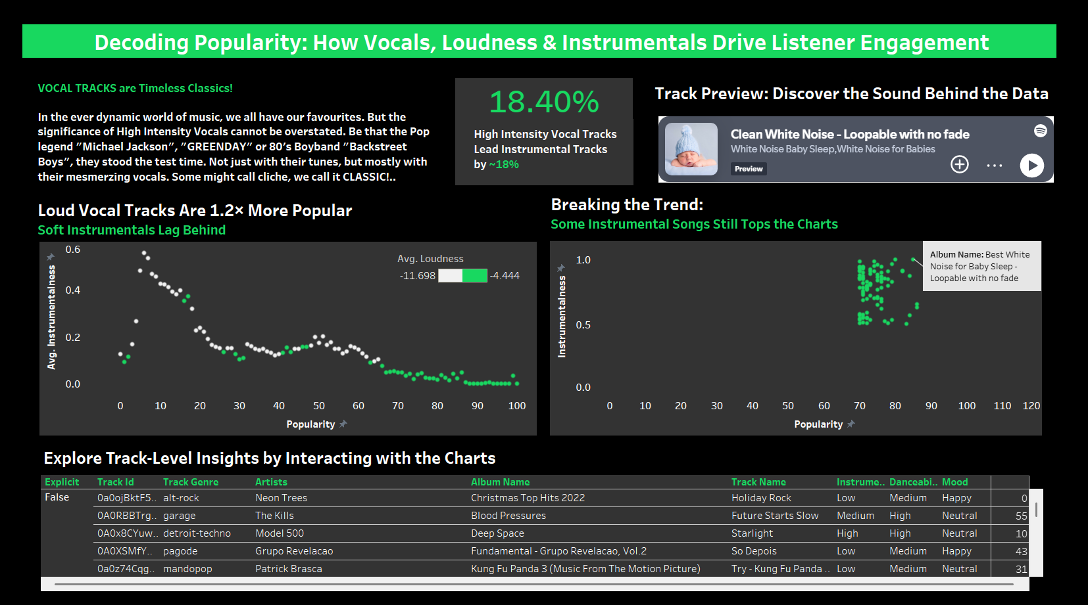

Slide 4
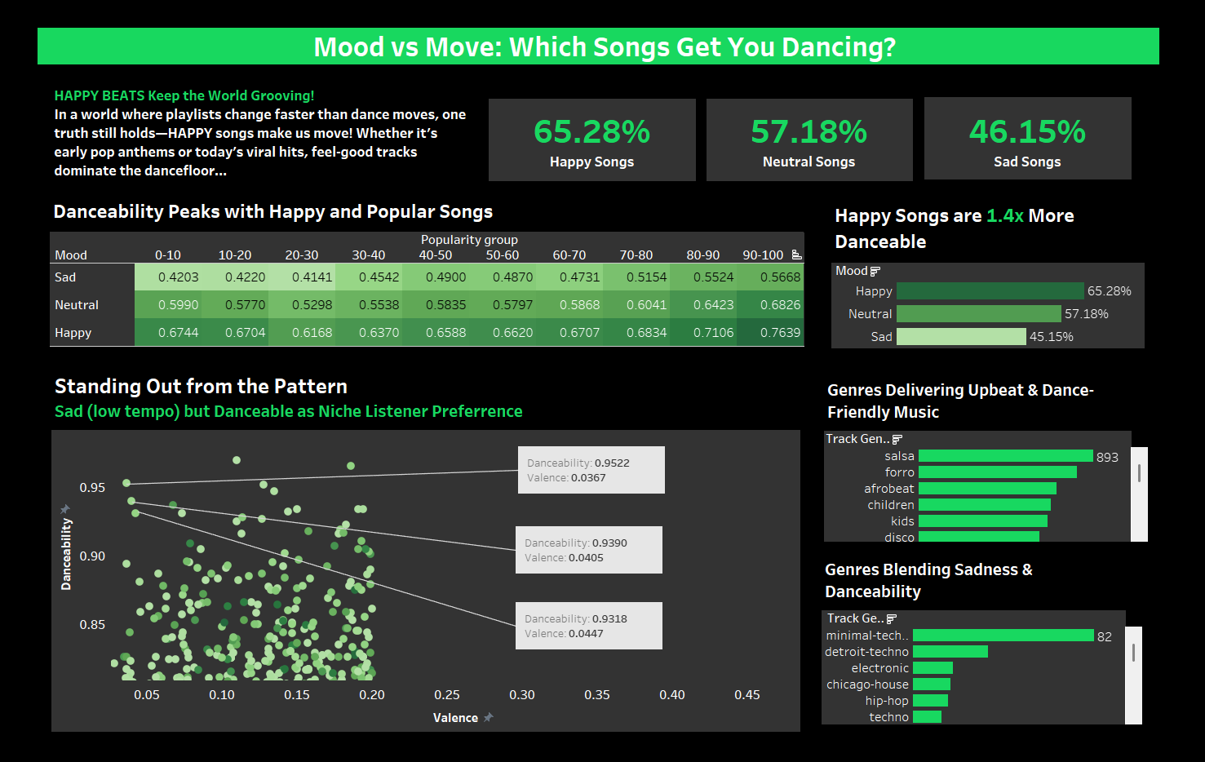

Slide 5
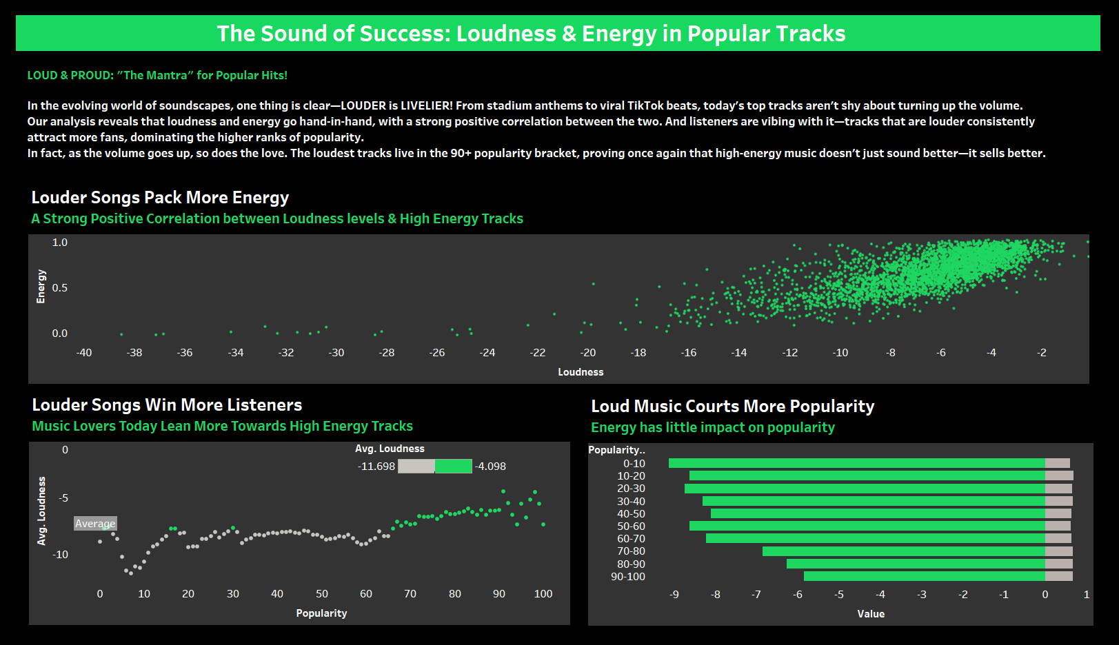

Slide 6
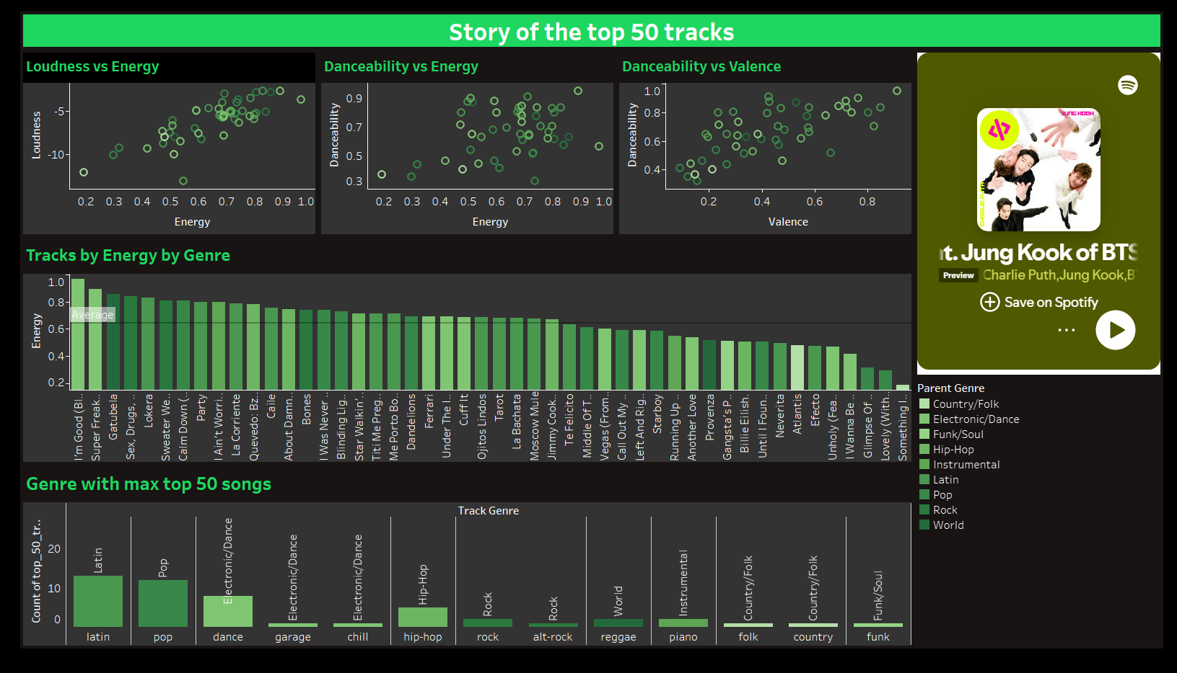

Slide 7
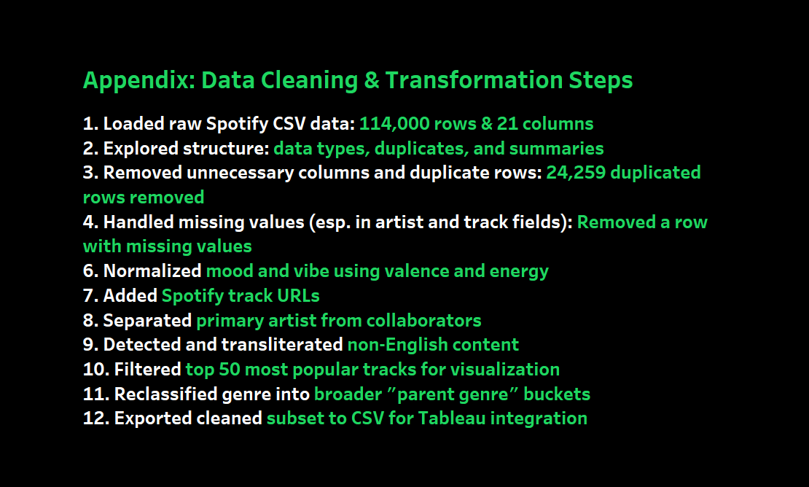

Slide 8
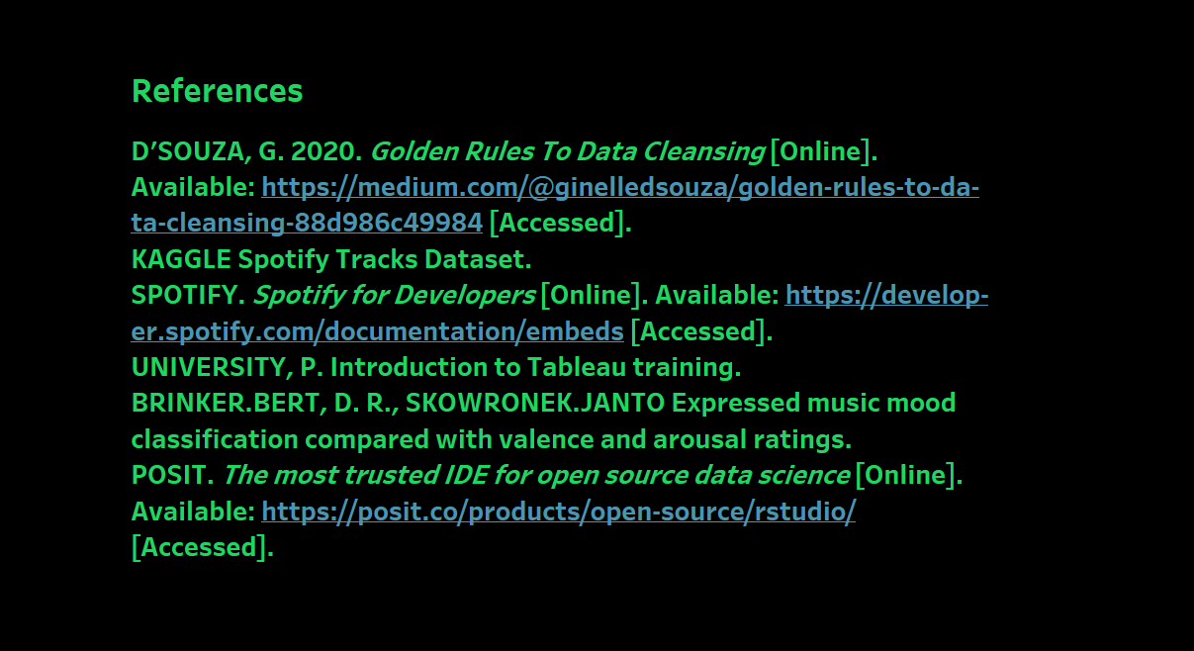

Slide 9
Presentation Video Link
https://youtu.be/i4xXil1X53g?si=JoHpOsV7gH6CL-LM

